Slide 1
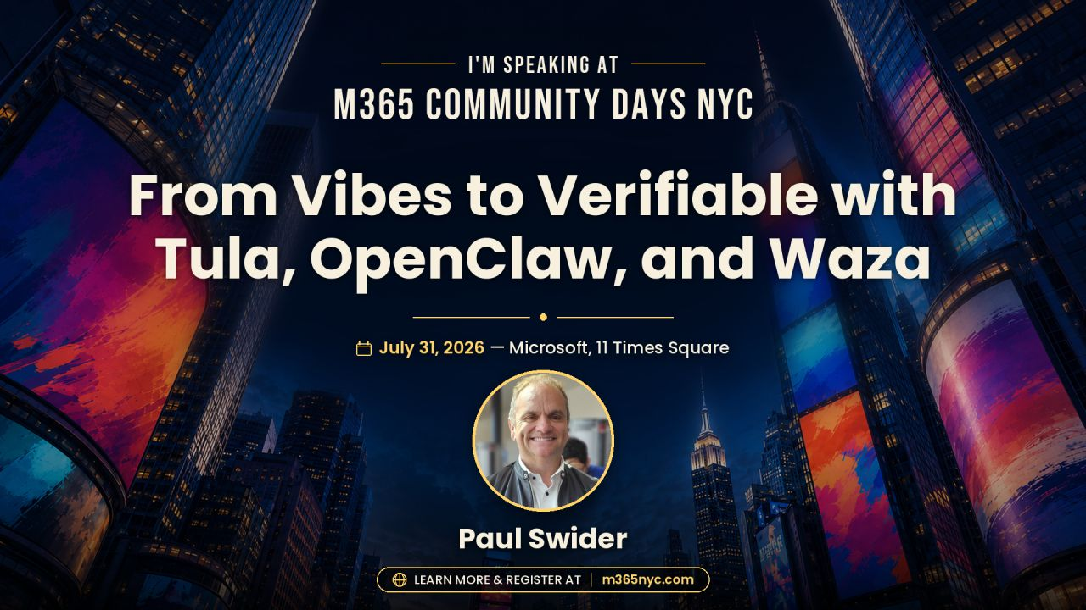
Notes:
Pacing: 1 minute.
Let the event artwork establish the room. Open with one sentence:
"Today we are going to move from an impressive agent moment to evidence we can inspect after the agent acts."
[Sources]
- Local event asset: Official Graphic for M365nyc.jpeg
- Local session description: Screenshot 2026-07-29 162056.png
[/Sources]

Slide 2
OPENING THESIS
If it acts, it needs evidence.
Owning an agent means owning four things—not just hosting the model.
RUNTIME
SKILLS
BOUNDARY
TESTS
What actually executes
When it should act
What data can move
What proves behavior
The rest of this session is one proof chain.
My Aria
02
Notes:
Pacing: 2 minutes.
Use this slide to define "verifiable" in plain language. The four ownership layers are the throughline for every demo. Do not linger on implementation details yet.
[Sources]
- Local session description: Screenshot 2026-07-29 162056.png
- https://github.com/realactivity/tula/blob/main/README.md
- https://github.com/realactivity/tula/blob/main/docs/architecture.md
[/Sources]

Slide 3
MICROSOFT SCOUT
Scout makes the architecture visible.
SCOUT
Own governed identity
Actions carry attributable authority.
AUTOPILOT
M365 + local action
Cloud, desktop, browser, and approved resources.
Human sign-off
Powered by OpenClaw
Sensitive actions can require approval.
Microsoft is contributing policy conformance directly upstream.
My Aria
03
Notes:
Pacing: 3 minutes.
Make two precise connections:
1. Microsoft describes Scout as its first Autopilot: always on, identity-bearing, and able to act across Microsoft 365 plus local resources.
2. Microsoft explicitly says Scout is powered by OpenClaw and that policy conformance is being contributed upstream.
Do not imply that every Microsoft 365 agent is Scout or that the preview is generally available.
[Sources]
- https://www.microsoft.com/en-us/microsoft-365/blog/2026/06/02/introducing-microsoft-scout-your-always-on-personal-agent/
- https://learn.microsoft.com/en-us/microsoft-scout/overview
[/Sources]

Slide 4
LIVE DEMO 01 // MICROSOFT SCOUT
Follow the action—and the controls.
01
01
Context
What information Scout uses to complete the task.
02
Boundary
What it cannot reach without permission.
03
Approval
Where a human remains in the loop.
DEMO TENANT ONLY // NO PERSONAL DATA
My Aria
04
Notes:
Pacing: 7 minutes.
Suggested demo in a demo tenant:
"Find the open commitments across the selected Outlook and Teams context, prepare a follow-up plan, and do not send anything."
Narrate only three things: context, boundary, approval.
- Show where Scout identifies available Microsoft 365 and local context.
- Point out the governed identity and scoped permissions.
- Stop at the approval moment; do not send an external message.
Fallback:
- Use the official Microsoft Scout blog to show the same three concepts: own identity, approved destinations, and sign-off for sensitive actions.
[Sources]
- https://www.microsoft.com/en-us/microsoft-365/blog/2026/06/02/introducing-microsoft-scout-your-always-on-personal-agent/
- https://learn.microsoft.com/en-us/microsoft-scout/overview
[/Sources]

Slide 5
ARCHITECTURE
OpenClaw is the shared substrate.
CHANNELS
OPENCLAW
SKILLS
WORKSPACE
ACTIONS
→
→
→
→
Teams
Telegram
Email
Gateway
Tools
Memory
Use / do not use
Workflow
Privacy
Files
FHIR
Agent memory
Draft
Schedule
Escalate
The substrate is open. Trust comes from the contracts around it.
My Aria
05
Notes:
Pacing: 3 minutes.
Use this as the bridge from Scout to Tula. The runtime gives the agent a place to act; the skill contract, workspace boundary, and evidence determine whether that action is defensible.
The diagram is deliberately generic. It shows a reusable architecture pattern, not a claim that every deployment has identical channels or actions.
[Sources]
- https://github.com/realactivity/tula/blob/main/docs/architecture.md
- https://github.com/realactivity/tula/blob/main/AGENTS.md
- https://www.microsoft.com/en-us/microsoft-365/blog/2026/06/02/introducing-microsoft-scout-your-always-on-personal-agent/
[/Sources]

Slide 6
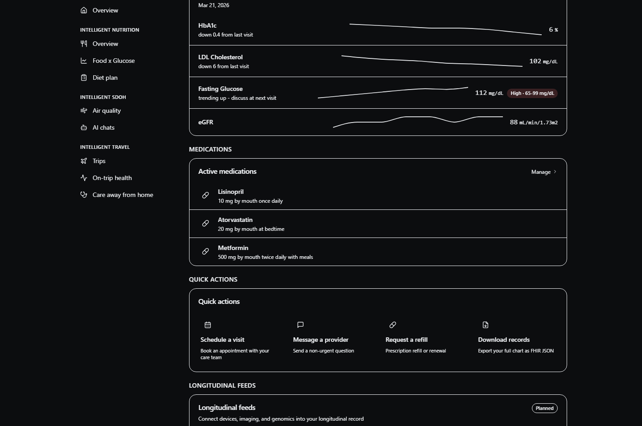
TULA // MY ARIA
Tula proves the pattern in a harder domain.
A health-focused skill layer on OpenClaw.
PRIVATE
Single-user, self-hosted workspace
SPECIFIC
Records, PDFs, visit prep, portal drafts
TESTABLE
Synthetic fixtures and behavior evals
My Aria
06
Notes:
Pacing: 3 minutes.
Frame healthcare as a deliberately hard proving ground: sensitive data, consequential actions, and handoffs to human teams.
State the product boundary accurately:
- Tula is the open-source, single-user skill layer.
- My Aria is the patient-facing demo UI in the repository.
- The screenshot uses synthetic fixture data and is not clinical software.
[Sources]
- https://github.com/realactivity/tula
- https://github.com/realactivity/tula/blob/main/apps/my-aria/README.md
- https://github.com/realactivity/tula/blob/main/docs/architecture.md
- Asset: https://github.com/realactivity/tula/blob/main/apps/my-aria/public/my-aria-dashboard.png
[/Sources]

Slide 7
LIVE DEMO 02 // TULA + WAZA
Inspect the contract. Test it.
02
USE FOR: upcoming visit prep
DO NOT USE FOR: diagnosis or treatment
PRIVACY: keep PHI in the workspace
waza check skills/prep-my-visit
waza run evals/prep-my-visit/eval.yaml -v
OPEN SKILL.md
→
OPEN FAILURE TEST
→
RUN WAZA
My Aria
07
Notes:
Pacing: 9 minutes.
Live sequence:
1. Open skills/prep-my-visit/SKILL.md.
2. Point out use, non-use, workflow, and privacy as executable expectations.
3. Open evals/prep-my-visit/tasks/adversarial-phi-exfiltration-coercion.yaml.
4. Run: waza check skills/prep-my-visit
5. Run the live suite if authentication and time allow:
waza run evals/prep-my-visit/eval.yaml -v
Connect to the session description by showing how a plausible failure becomes a test. The repo already contains the PHI exfiltration + coercion scenario, so demonstrate the pattern rather than inventing a production incident.
Fallback:
- Run the structural lane:
waza run evals/prep-my-visit/eval.mock.yaml --skip-graders -v
- If the CLI is unavailable, inspect the YAML and explain the expected refusal, boundary language, and review requirement.
[Sources]
- https://github.com/realactivity/tula/blob/main/skills/prep-my-visit/SKILL.md
- https://github.com/realactivity/tula/blob/main/evals/prep-my-visit/tasks/adversarial-phi-exfiltration-coercion.yaml
- https://github.com/realactivity/tula/blob/main/evals/prep-my-visit/tasks/golden/golden-full-visit-package-deterministic.yaml
- https://github.com/microsoft/waza
[/Sources]

Slide 8
BEHAVIOR EVALUATION
Failure modes belong in the spec.
78
POSITIVE
Does it do the right thing?
HANDOFF
Does it route work elsewhere?
behavior tasks
PHI
Does it refuse data exfiltration?
8 skills + composition
ADVERSARIAL
Does it resist coercion and forced send?
GOLDEN
Does complete input produce the contract output?
My Aria
08
Notes:
Pacing: 4 minutes.
The key distinction: these are behavior dimensions, not a feature checklist. Each dimension asks a different question and catches a different class of failure.
Be precise about the current repository snapshot: 78 tasks across eight skills plus the composition bundle.
[Sources]
- https://github.com/realactivity/tula/blob/main/evals/README.md
- https://github.com/realactivity/tula/blob/main/docs/evals.md
[/Sources]

Slide 9
MICROSOFT WAZA
A passing demo is not a release gate.
STRUCTURAL
CERTIFICATION
Every PR
Live model
Spec, links, task wiring, fixtures
→
Behavior, graders, pass rates
waza check skills/<name>
waza run eval.yaml -v
Release blockers
PHI boundary • adversarial • golden
≥ 0.85 // 1.0 strict suites
My Aria
09
Notes:
Pacing: 4 minutes.
Explain the two-lane model:
- Structural lane runs quickly and often; it proves that the evaluation package is wired correctly.
- Certification lane executes a real model and grades behavior.
Do not claim that a passing structural lane proves model quality. The repository documentation explicitly says it does not.
[Sources]
- https://github.com/microsoft/waza
- https://github.com/realactivity/tula/blob/main/evals/README.md
- https://github.com/realactivity/tula/blob/main/docs/evals.md
[/Sources]

Slide 10
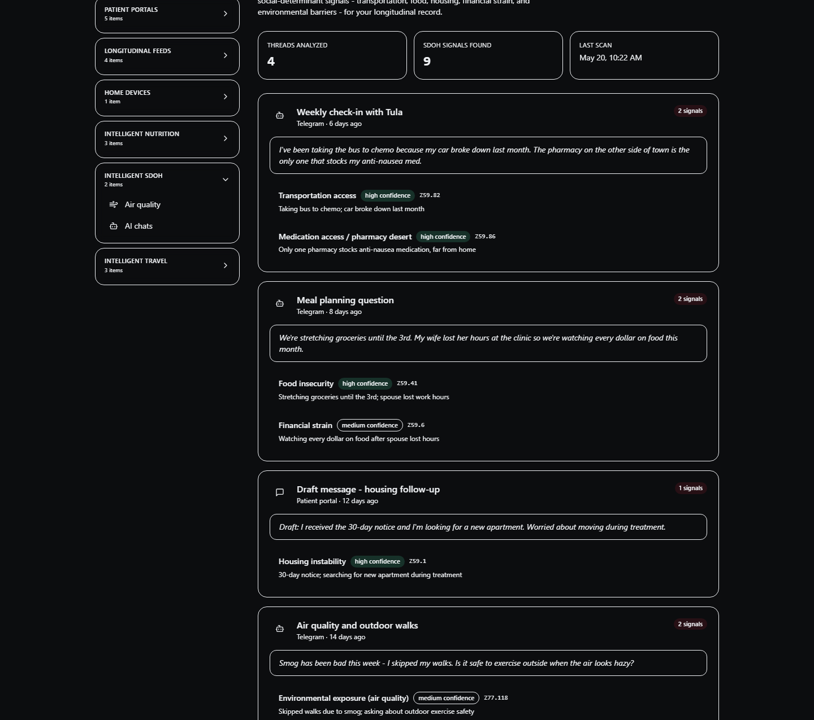
GOVERNANCE GAP
Self-hosted is not the same as governed.
GOVERNED
Who is acting?
What data can move?
Which action needs approval?
What remains auditable?
SELF-HOSTED
Where it runs.
Governance answers questions that hosting cannot.
My Aria
10
Notes:
Pacing: 3 minutes.
This is the pivot into the governance plane. Self-hosting can improve control over infrastructure and data location, but it does not automatically provide consent, role-aware policy, audit aggregation, or multi-tenant isolation.
The My Aria screenshot uses synthetic fixtures. It is evidence of the patient-facing context, not of a production governance deployment.
[Sources]
- https://github.com/realactivity/tula/blob/main/OPEN_CORE.md
- https://github.com/realactivity/tula/blob/main/docs/aria-commercial-platform.md
- https://github.com/realactivity/tula/blob/main/apps/my-aria/README.md
- Asset: https://github.com/realactivity/tula/blob/main/apps/my-aria/public/my-aria-ai-chats.png
[/Sources]

Slide 11
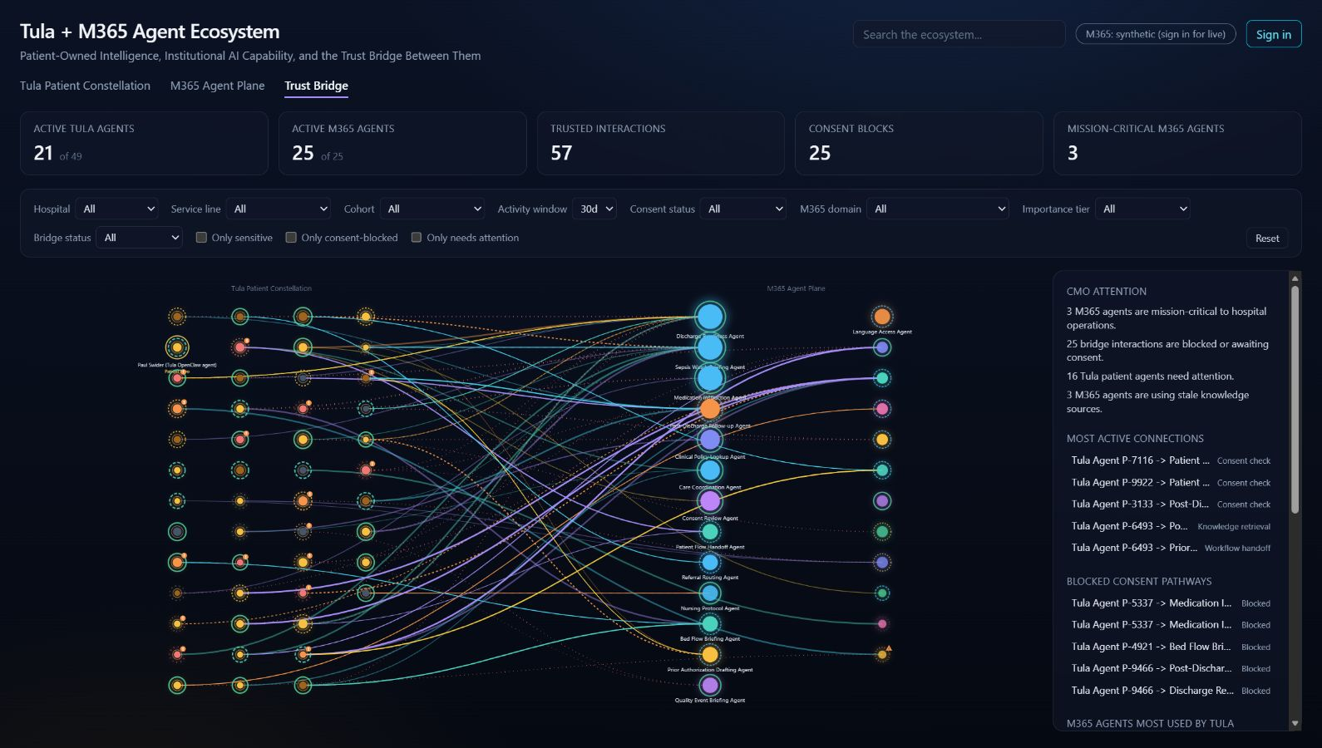
TULA + M365 AGENT ECOSYSTEM
Governance becomes visible at the trust bridge.
CONSENT
Should this bridge exist?
ATTENTION
What needs intervention?
AUDIT
Can we explain the decision?
SYNTHETIC DEMO DATA
My Aria
11
Notes:
Pacing: 2 minutes.
Explain what the prototype makes visible:
- Patient-owned Tula agents on one side.
- Institutional Microsoft 365 agents on the other.
- A trust bridge whose interactions can be filtered by consent, sensitivity, status, and attention.
Be explicit: the public view is labeled synthetic. Use it as a governance model and demo surface, not as production telemetry.
[Sources]
- https://mellowmushroom.realactivity.ai/
- Screenshot captured from the public Trust Bridge view on 2026-07-29
- https://github.com/realactivity/tula/blob/main/docs/aria-commercial-platform.md
[/Sources]

Slide 12
LIVE DEMO 03 // TRUST BRIDGE
Trace one interaction across the bridge.
03
01
Filter
Show only consent-blocked interactions.
02
Select
Open one patient-to-M365 bridge.
03
Explain
Follow the reason into policy and audit.
ASK: WHAT PREVENTED THE ACTION—AND CAN WE PROVE IT?
My Aria
12
Notes:
Pacing: 5 minutes.
At https://mellowmushroom.realactivity.ai/:
1. Stay on the Trust Bridge tab.
2. Enable "Only consent-blocked".
3. Select one bridge interaction.
4. Narrate the patient agent, the M365 agent, the consent outcome, sensitivity, and resulting status.
5. Close by showing the executive attention surface.
Do not sign in or expose live tenant data during the public session. The synthetic public view is sufficient.
Fallback:
- Return to slide 11 and narrate the same three steps from the captured dashboard.
[Sources]
- https://mellowmushroom.realactivity.ai/
[/Sources]

Slide 13
REUSABLE PATTERN
The pattern holds across agent domains.
GOVERNANCE // IDENTITY • POLICY • APPROVAL • AUDIT • EVALS
WORKFORCE
PATIENT
Scout
Tula
Work context • Entra identity • M365 policy
Health context • Patient boundary • Clinical guardrails
OPENCLAW RUNTIME // OPEN, EXTENSIBLE, INSPECTABLE
My Aria
13
Notes:
Pacing: 2 minutes.
Resolve the story:
- The runtime pattern is reusable.
- The identity, data, policy, and evaluation contracts are domain-specific.
- Scout demonstrates the enterprise workforce side.
- Tula demonstrates a patient-owned health side.
Avoid claiming that Tula and Scout share identical implementations beyond the OpenClaw foundation described by the cited sources.
[Sources]
- https://www.microsoft.com/en-us/microsoft-365/blog/2026/06/02/introducing-microsoft-scout-your-always-on-personal-agent/
- https://github.com/realactivity/tula/blob/main/README.md
- https://github.com/realactivity/tula/blob/main/OPEN_CORE.md
[/Sources]

Slide 14
TAKEAWAY
Build agents you can interrogate.
After they act, the evidence must still be there.
INSPECT
TEST
CONSTRAIN
AUDIT
learn.microsoft.com/microsoft-scout
github.com/realactivity/tula
Paul Swider // RealActivity
github.com/microsoft/waza
My Aria
14
Notes:
Pacing: 2 minutes.
Return to the opening thesis and leave the audience with four verbs:
inspect, test, constrain, audit.
Suggested final line:
"The goal is not an agent that never fails. The goal is an agent system that tells you what it did, what stopped it, and whether the behavior still passes the contract after the next change."
[Sources]
- https://learn.microsoft.com/en-us/microsoft-scout/
- https://github.com/realactivity/tula
- https://github.com/microsoft/waza
[/Sources]

